Slide 1
Graphing Inequalities

Slide 2

Inequality signs
< “is smaller than”
> “is greater than”
≤ “is greater or equal to”
≥ “is smaller or equal to ”

Slide 3
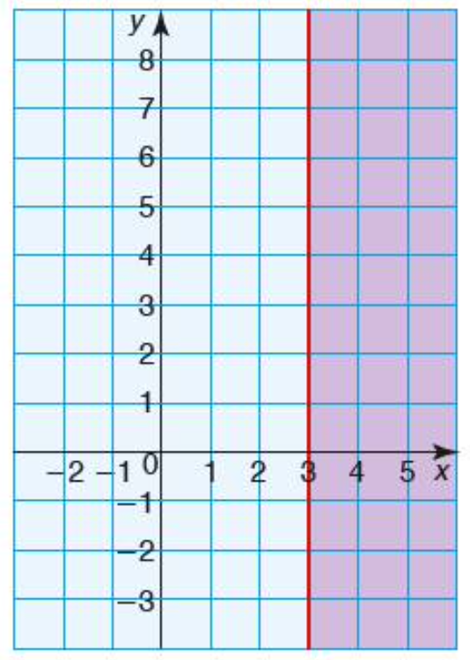


Graphing

Slide 4
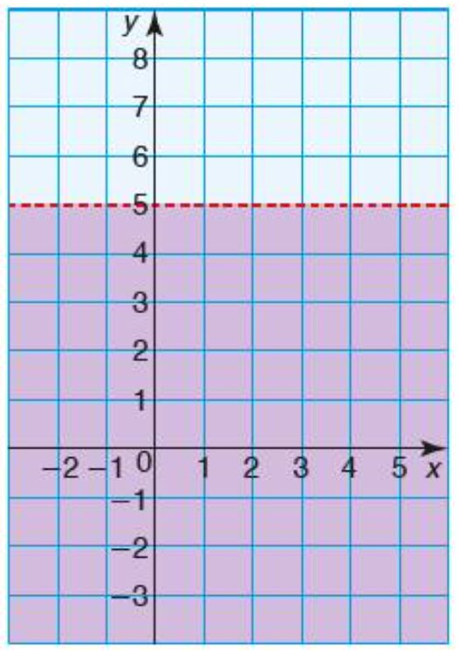


Graphing

Slide 5
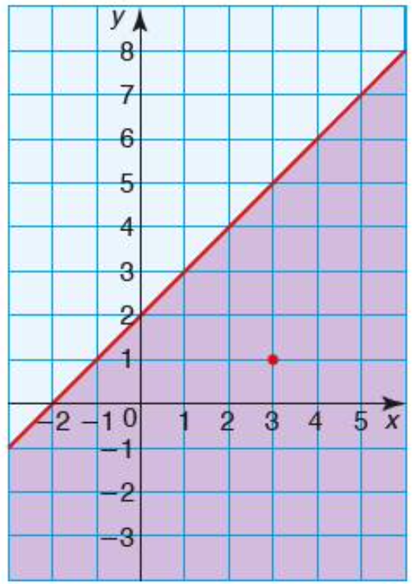


Graphing

Slide 6
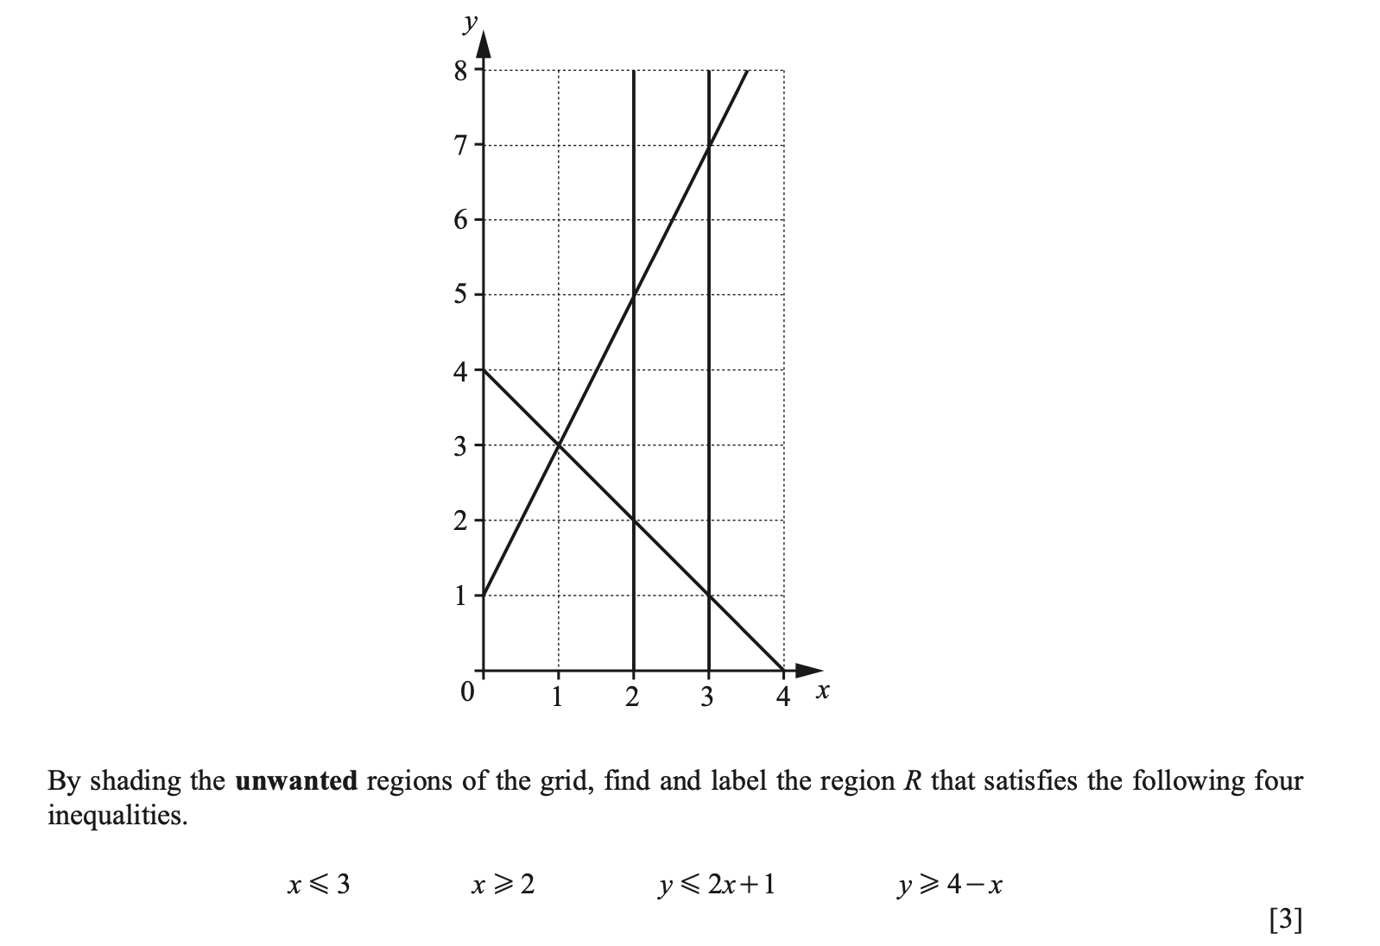

Slide 7
